Slide 1

Movie Rental data analysis
Project by, Date- 12/09/2023
Name-Vighnesh S Udaiyar Mentor: Sagar Bhilare
Course Name- Data Analysis
Batch –January 2023
Wave- DAS31

Slide 2
Objective
The objective of the project is to use MySQL to analyze the data of a movie rental store for further growth and improved business.
Introduction
Movie on Rent is a chain of movie rental stores operating in a certain country .It has a vast of collection of movies in DVD and Blue Ray disc formats.
The management of the company wants to analyze what kind of movies are most often rented, which genres they belong to and which actors appeared in them .It will help the management to stock up the inventory as per audience preferences for improved business.
3

Slide 3
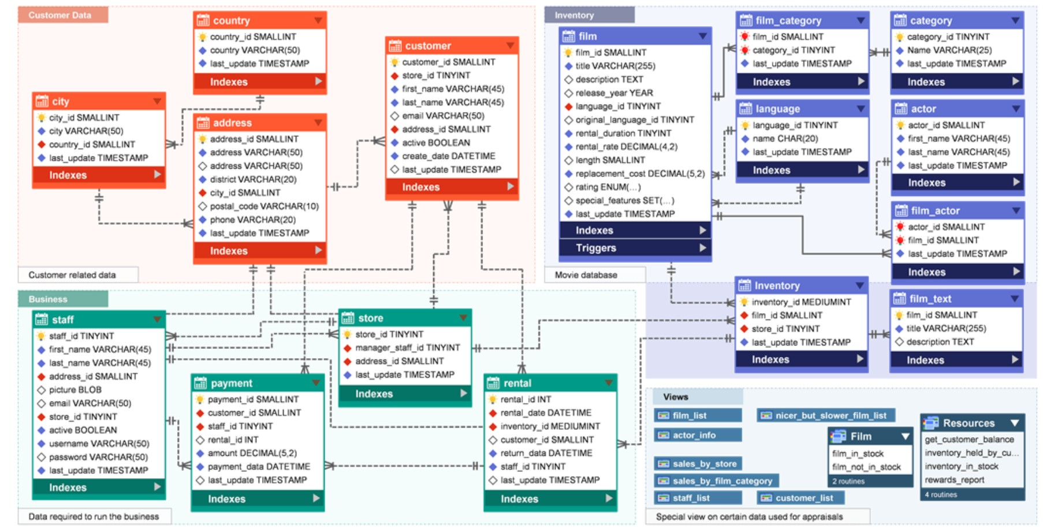
Sakila database schema diagram (er diagram)

Slide 4


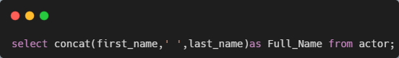
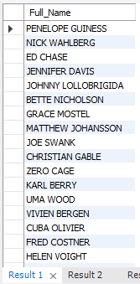
tASKS
Task-1:-Display the full names of actors available in the database
In this task the first name and last name are in two different columns. So, we need to join them and display them as a single name.
In this task , we used ‘concat’ method to combine first and last name.
We got a total of 200 actors names in this list.

Slide 5
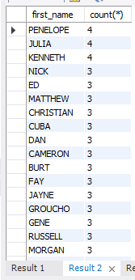
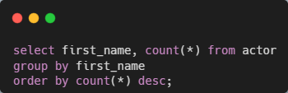
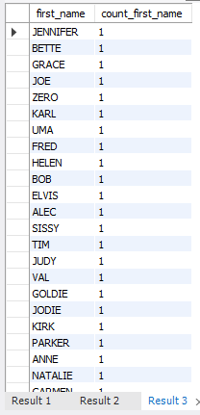
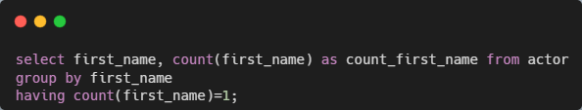
Task 2.1:- Display the number of times each first name appears in database.
Task-2.2:- What is the count of actors that have unique first name in the database. Display the first name of all these actors
In task 2.1, we got a total of 128 rows in output.
PENELOPE, JULIA, and KENNETH are the most repeated names in the database which is around 4 times.
In task 2.2, we got a total of 76 unique first names which is repeated only once.

Slide 6
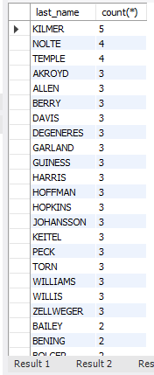
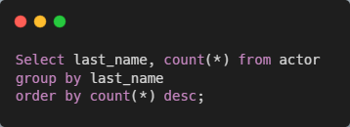
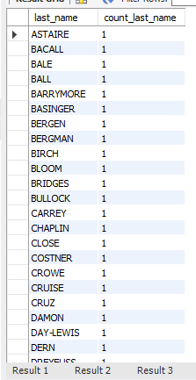
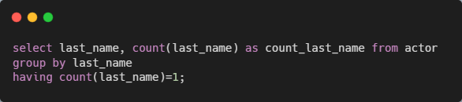
Task-3:-Display the number of times each last name appears in the database
Task-3.2:-Display all unique last names in the database.
In Task 3.1,There are total of 121 rows from the output.
The KILMER is the last_name which is repeated around 5 times.
In task 3.2 There are 66 unique actors last name in the table

Slide 7
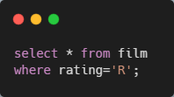
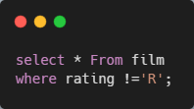
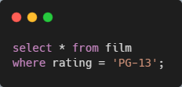
Task-4:-Display the list of records for the movies with the rating ‘R’
Task-4.2:- Display the list of the movies that are not rated ‘R’
Task-4.3:- Display the list of records for the movie that are suitable for audience below 13 years of age
In task 4, we got a total of 195 records with the ratings ‘R’
This is the restricted movies which is not suitable for underage customers.
In Task 4.2, There are 805 movies with not rating “R”.
This is not restricted movie and can be watched by all age
In Task 4.3, There are 223 movies that are suitable for audience below 13 years of age This movie records has PG-13 ratings (Parental Guide 13)

Slide 8
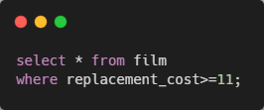
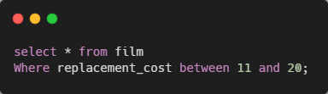
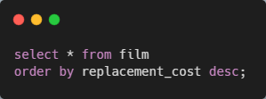
Task-5.1:-Display the list of records for the movies where the replacement cost is up to $11.
Task-5.2:- Display the list of records for the movies where the replacement cost is between $11 and $20
Task-5.3:-Display the list of records for the all movies in descending order of their replacement cost
In task 5.1, we got a total of 910 results of movies whose replacement cost is up to $11.
In task 5.2, There are 424 movies where the replacement cost is between $11 and $20 .
In task 5.3, The movie title “ARABIA DOGMA”, “BALLROOM MOCKINGBIRD”,” BLINDNESS GUN” and many more has highest replacement cost of 29.99.

Slide 9
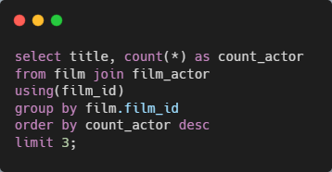
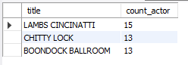
Task-6:-Display the names of the top 3 movies with the greatest number of actors
In this task, we need to display the top 3 movies with the largest number of actors.
Film and film actor are two different tables in the database and we need to join them. For this, we use the ‘JOIN’ method.
LAMBS CINCINATTI is the movie with the highest number of actors 15

Slide 10
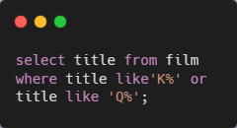
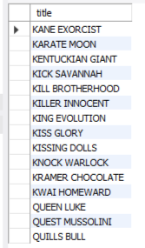
Task-7:-'Music of Queen' and ‘Kris Kristofferson' have seen an unlikely resurgence. As an unintended consequence, films starting with the letters 'K' and 'Q' have also soared in popularity. Display the titles of the movie starting with the letters 'K' and 'Q'
There 12 movies starting with letter “K” and 3 movies starting with letter “Q”.
These movies are most often preferred by the customer.

Slide 11
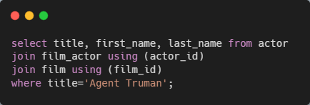
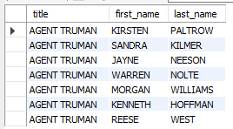
Task-8:-The film 'Agent Truman' has been a great success.-- Display the names of all actors who appeared in this film
“Agent Truman” has been a great success and its very popular movie and there are 7 actors who appeared in this film and they are KIRSTEN PALTROW, SANDRA KILMER, JAYNE NEESON, WARREN NOLTE, MORGAN WILLIAMS, KENNETH HOFFMAN, REESE WEST.

Slide 12
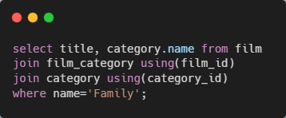
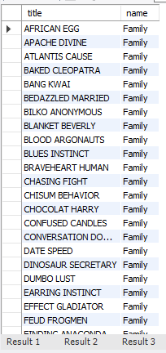
Task-9:-Sales have been lagging among young families, so the management wants to promote family movies. Identify all the movies categorized as family film
There 69 movies that family can watch.
These movies can be considered and stock it more for improved business.

Slide 13
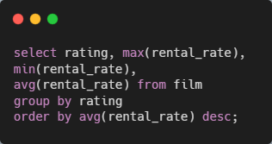
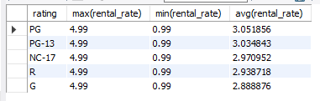
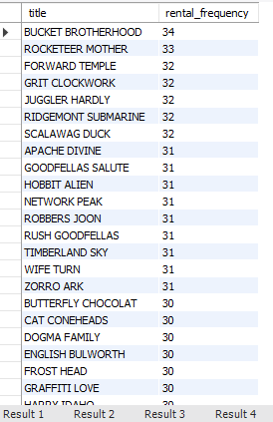
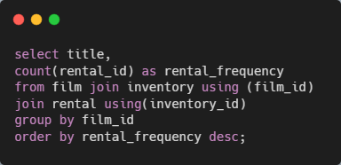
Task-10.1:-Display the maximum, minimum, and average rental rates of movies based on their ratings.
Task-10.2:- Display the movies in descending order of their rental frequencies.
In task 10.1, we take the rating, maximum, minimum, and average of each rating.
In task 10.2, we got a total of 958 titles in the output.
The most rented movies are BUCKET BROTHERHOOD, ROCKETEER MOTHER, FORWARD TEMPLE, GRIT CLOCKWORK JUGGLER HARDLY, RIDGEMONT SUBMARINE and many more have been rented for 32 to 34 times.
The TRAIN BUNCH has the lowest rental ratings in the list.

Slide 14
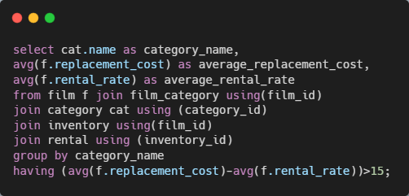
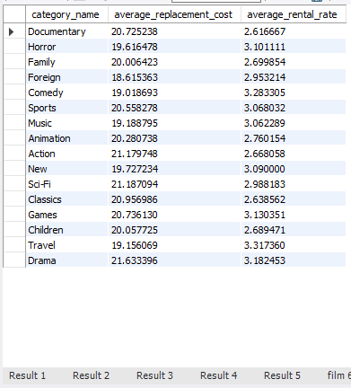
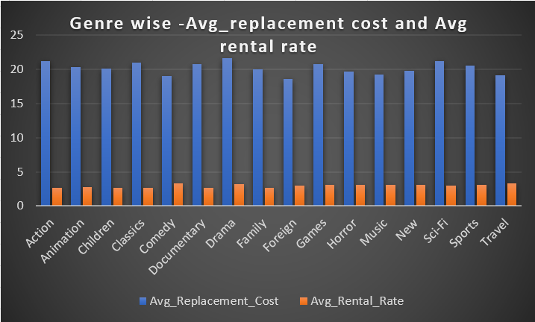
Task-11:- In how many film categories, the difference between the average film replacement cost(disc-DVD/Blue Ray). The average film rental rate is greater than $15
In task 11, we want to find the category–wise difference between the average replacement cost and the average rental rate of the film.
The Drama has the highest avg replacement cost
The Travel has the highest avg rental rate.

Slide 15
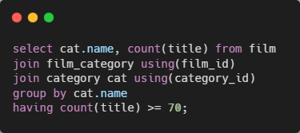
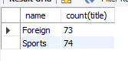
Task-12:- Display the film categories which the number of movies is grater than 70
The film categories in which the number of movies is greater than 70 are:
Sports 74 movies
Foreign 73 movies

Slide 16
Conclusion
The sports category has the highest movie count in the dataset.
PG and PG-13 have the highest rental rate in ratings.
The Drama category has the highest replacement cost in the dataset.
As per data, the listed categories are more preferred to rental by customers.
Horror
Comedy
Sports
Music
Games
Travel

Slide 17



THANK YOU
Sanket Bhosale

